Slide 1


E-Commerce Data Model
PROJECT GROUP – 5
Archita Kothari
Jayanth Kumar Boorgu
Nihal Reddy Komirelli
01

Slide 2
Overview
Objective
Design Document & ER Diagram
DDL Statements &
Data Population
Dashboard
The visual representation of data from DB is presented here using tableau
The objective of creating this database and how this DB is helpful to orgs is explained here
The end-end design of the database along with ER diagram are explained here
All the DDL statements and insertion statements used in DB are presented here

Slide 3

Objective
Data model on e-commerce marketplace gives end-to-end transaction view from initial stage to product being delivered.
Our data model includes exclusive offerings and profitable predictions for businesses.
Data model is helpful for many internal teams in making strategies to increase customer base and improve customer retention and overall experience.
Notes:
End to end transaction
Helpful for many teams
Our project contains database design for e-commerce marketplace, where we tried to explain how a business can manage their product prices and offerings based on units in stock
Our data model includes how offerings can be exclusive to help and how they let them analyze their profitable predictions. The model developed by us indicates how the companies incorporate discounts to arrange overall marketing and pricing strategies that result in sale increments.
Emotional connect with customers by encouraging them and giving them the best benefit is our motto on this development.

Slide 4
S
M
CX
Strategy Ops
Marketing Ops
Customer Experience
This DB is designed such a way that operation teams can strategies discounts on products based on the demand
One of the marketing strategy that we used in this DB is health-membership to target customers by giving reward points and increase the customer base.
One of the mottos of any org is customer satisfaction, Here the data and visual dashboards from database help the orgs to improve customer experience by looking into CX reviews at product and order level issues.

Slide 5

Design Document
This particular DB contains 15 entity tables with relationships in the normalized form that gives end-end workflow of an ecommerce org.
Each entity table and their relationships are explained in the design document below.
Design Document : Link
Notes:
Link: https://northeastern-my.sh

Slide 6

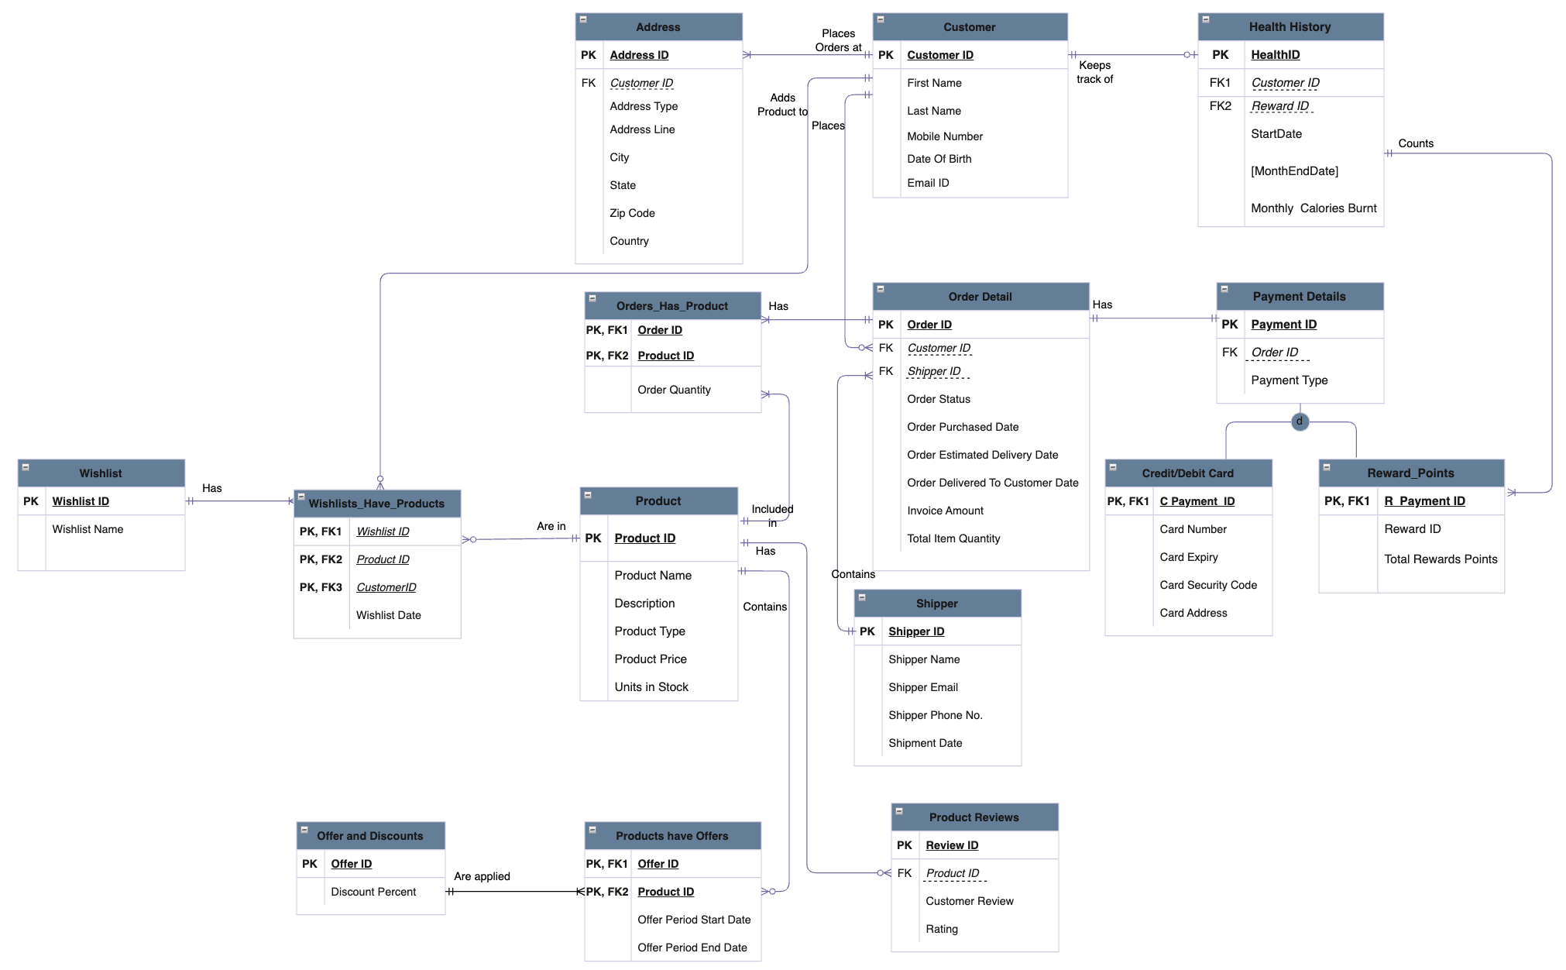
ER Diagram
6
Notes:
Customer: Details about customer, customer's multiple addresses, health history if exists(which counts the monthly calories burnt by the customer)
Order: Order details(which contains status of order, invoice etc), shipper, order has products
Product: Product(Units in Stock), Product Reviews, Wishlist, Wishlist has products
Payment: Payment details for each order, payment can be completed in 3 types: Card, Reward_Points, Cash
Promotions: Valid seasonal offers and discount on targeted products(for a particular period), health reward points

Slide 7


DDL Statements
Database creation contains 12 entities and 3 associative entities with multiple check constraints and key constraints.
Commands to each table and constraints are provided in the link below
Database objects: Stored Procedures, Views, Triggers and Encryptions are implemented on the database.
Commands for all the data objects are documented in the link below.
DDL Create Tables : Link
DDL Objects : Link
Notes:
Stored Procedure:
Views:
Triggers:
Encryption:

Slide 8
Data Population
Each table has minimum 15 entries inserted with consideration of cardinalities
Commands to insert into each table are provided in the link below considering the constraints and cardinalities according to our data model configuration.
DDL Population : Link

Slide 9
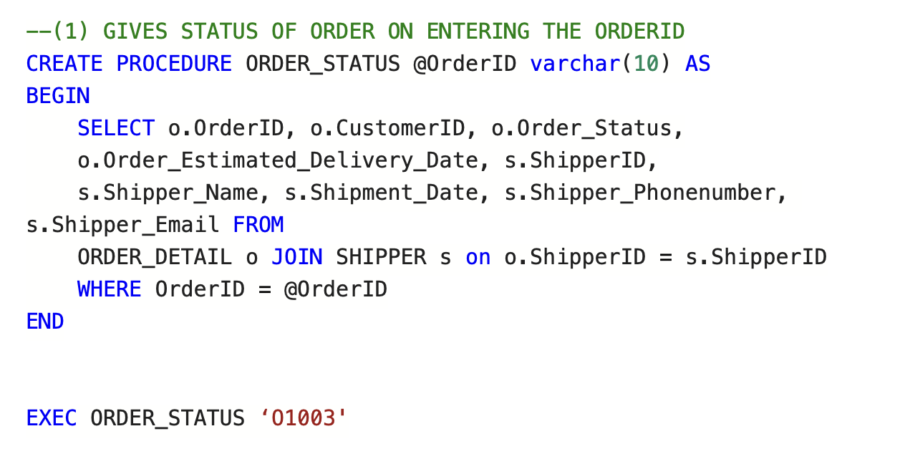
Stored Procedure

Slide 10
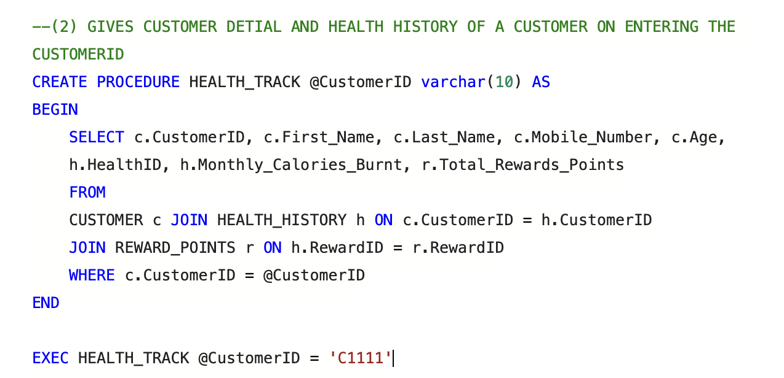
Stored Procedure

Slide 11
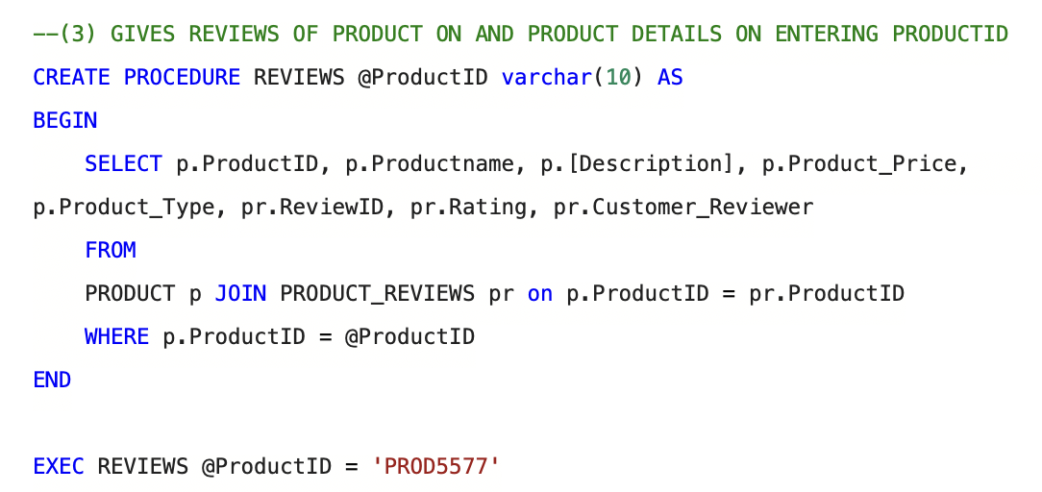
Stored Procedure

Slide 12
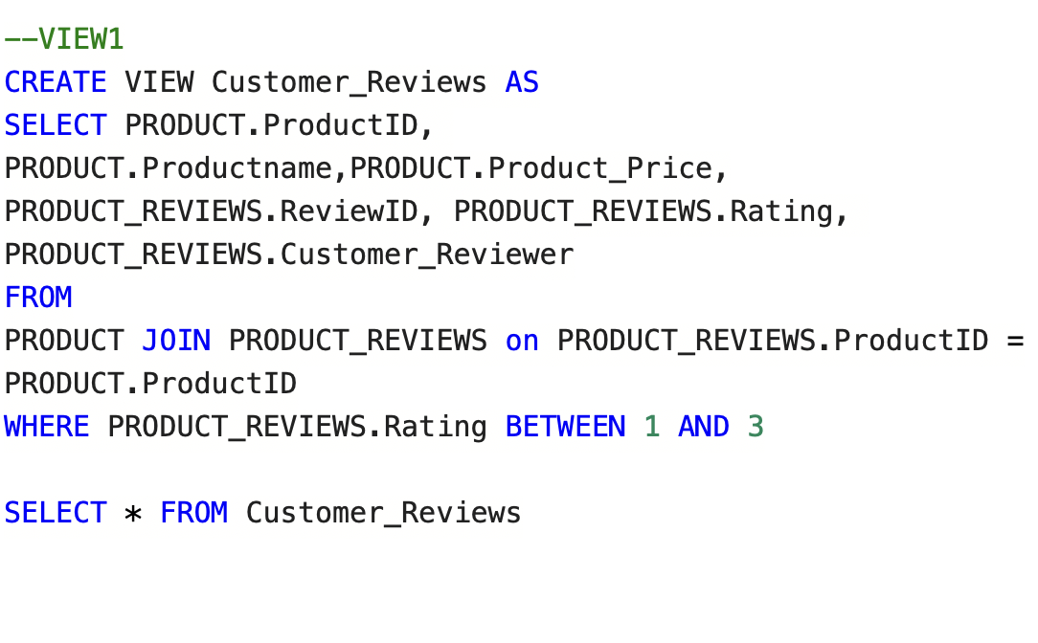
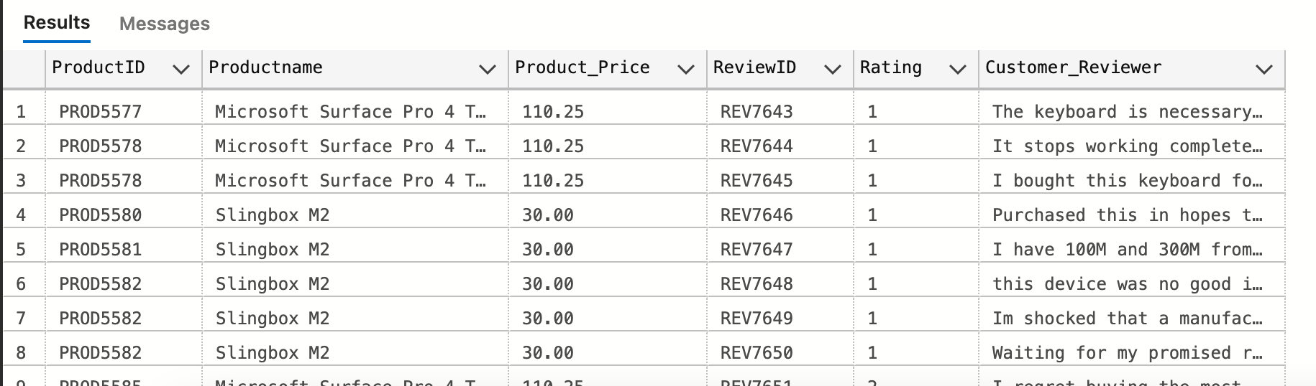
Views

Slide 13
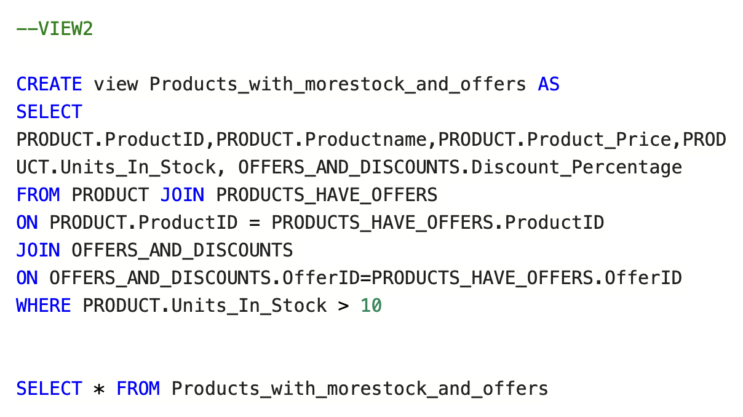
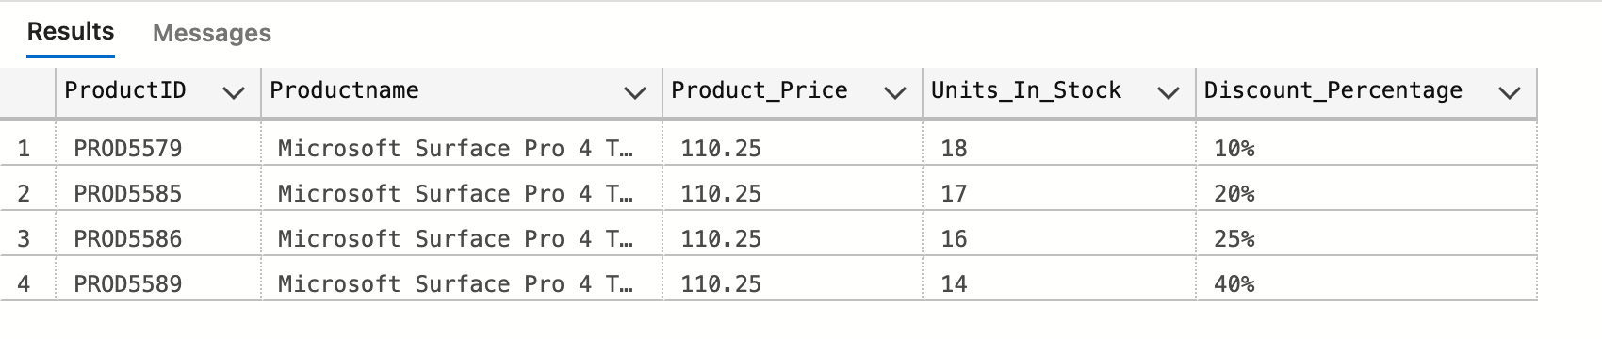
Views

Slide 14
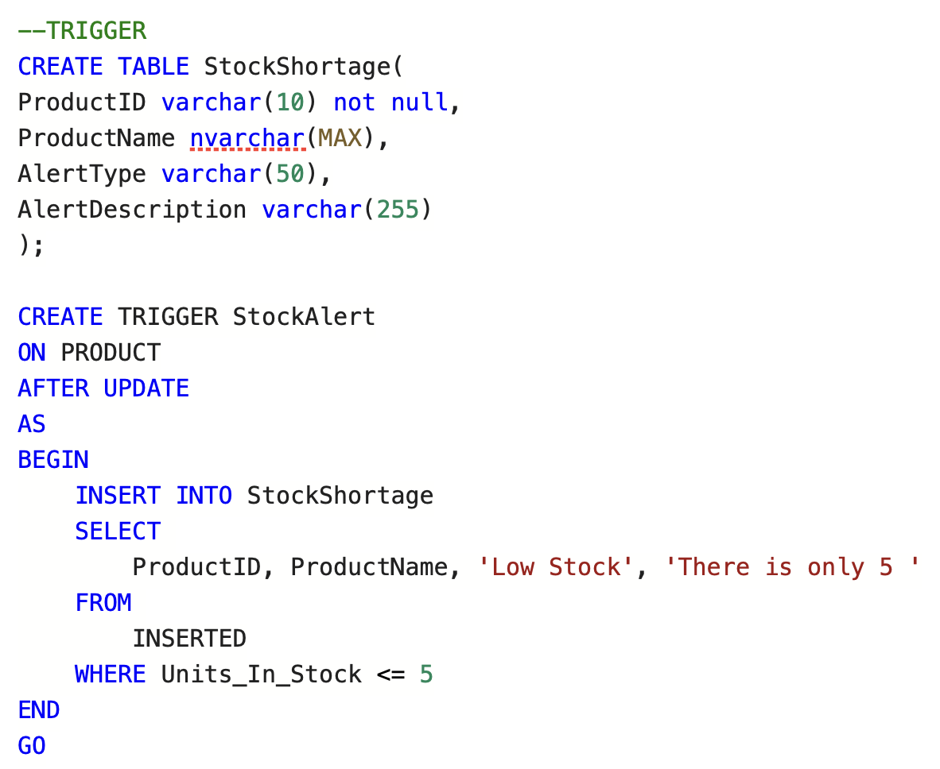
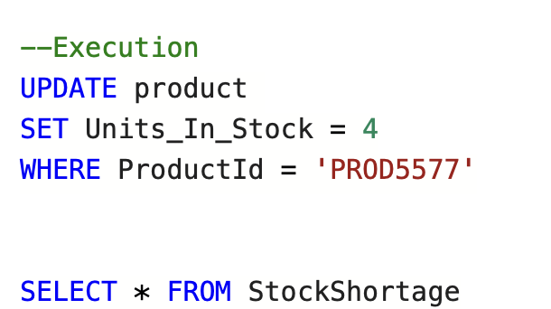
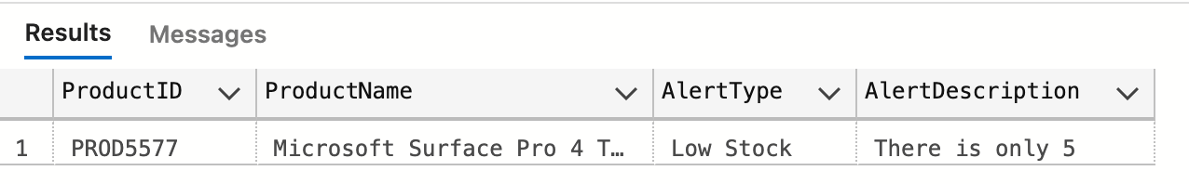
Trigger

Slide 15
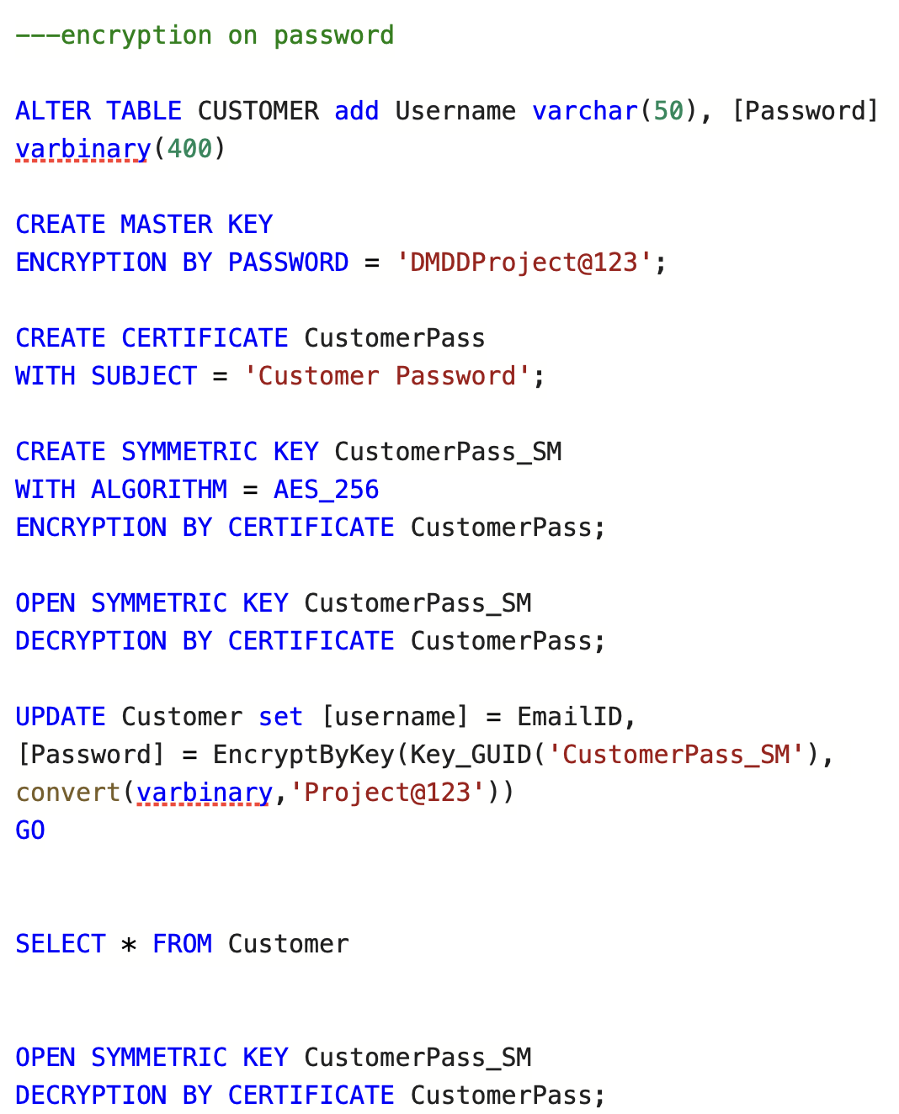
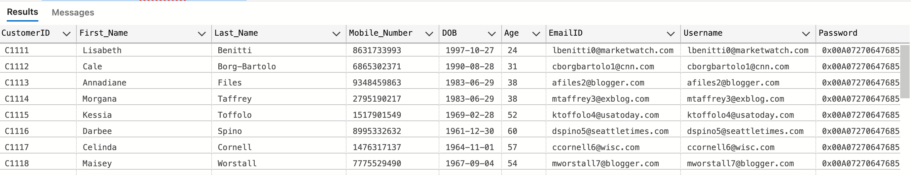
Encryption

Slide 16
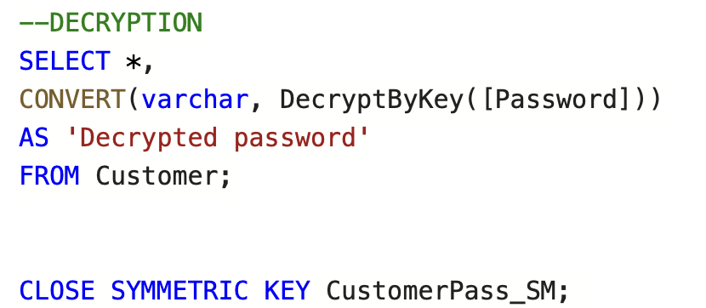
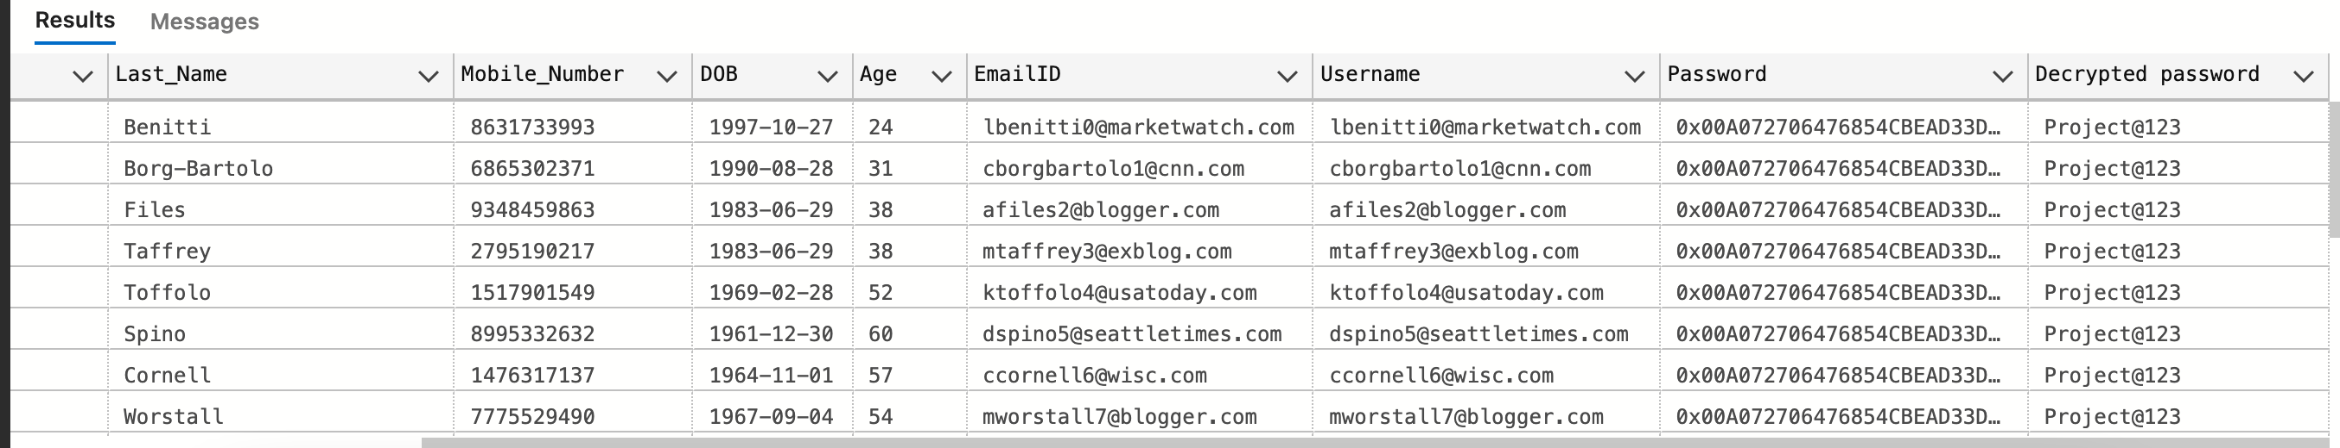
Decryption

Slide 17
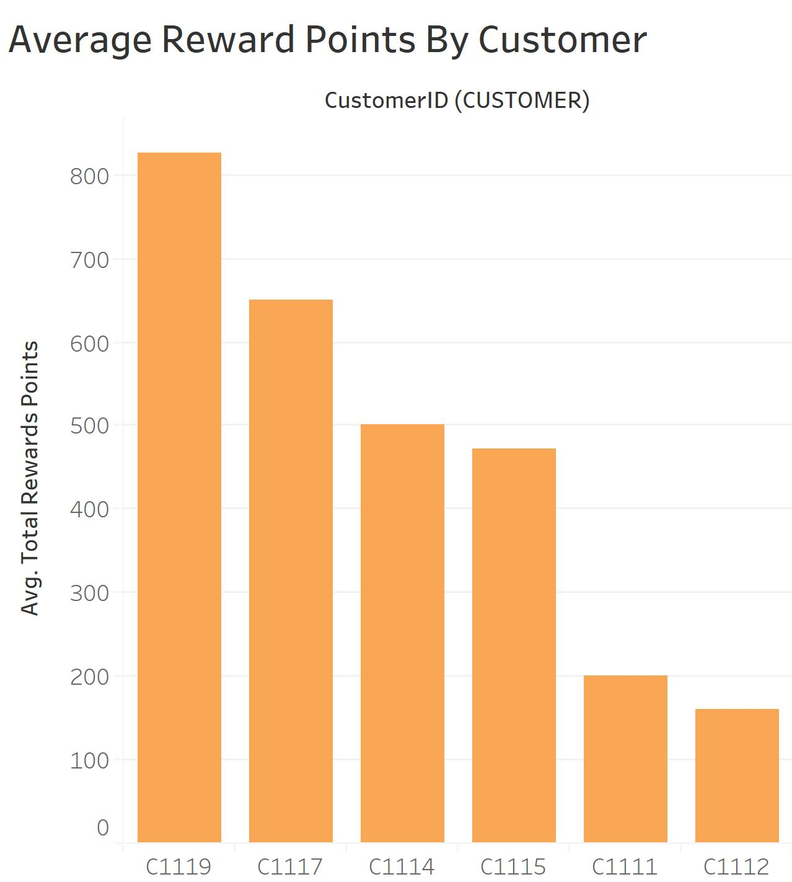
Health Reward Points
This bar-chat explains average reward points per customer who had enrolled in health-reward membership.
Notes:
By this, operations team can understand how well this health-reward strategy is working and can strategize the future scope.

Slide 18
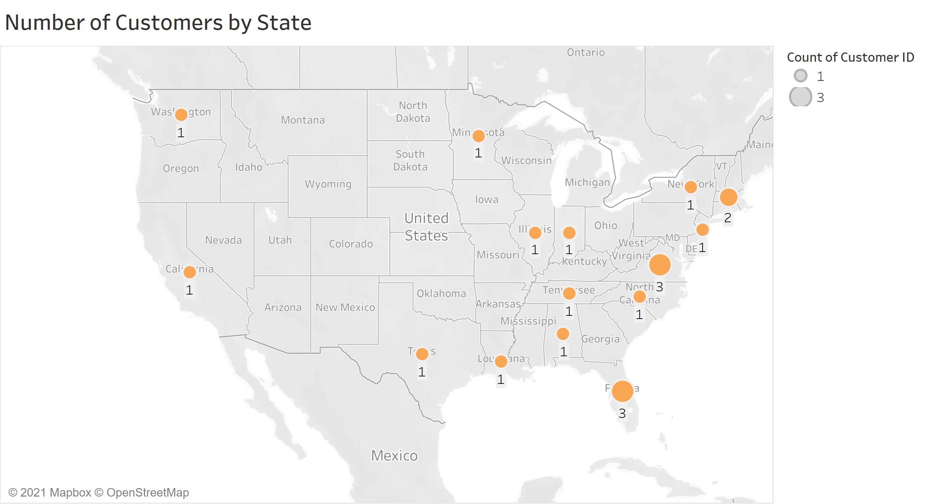
Regional level Customer view
This Map tells the customers city level view. By which a team gets to know from which region does the organization has more customers.
Notes:
The customers are from the west cost

Slide 19
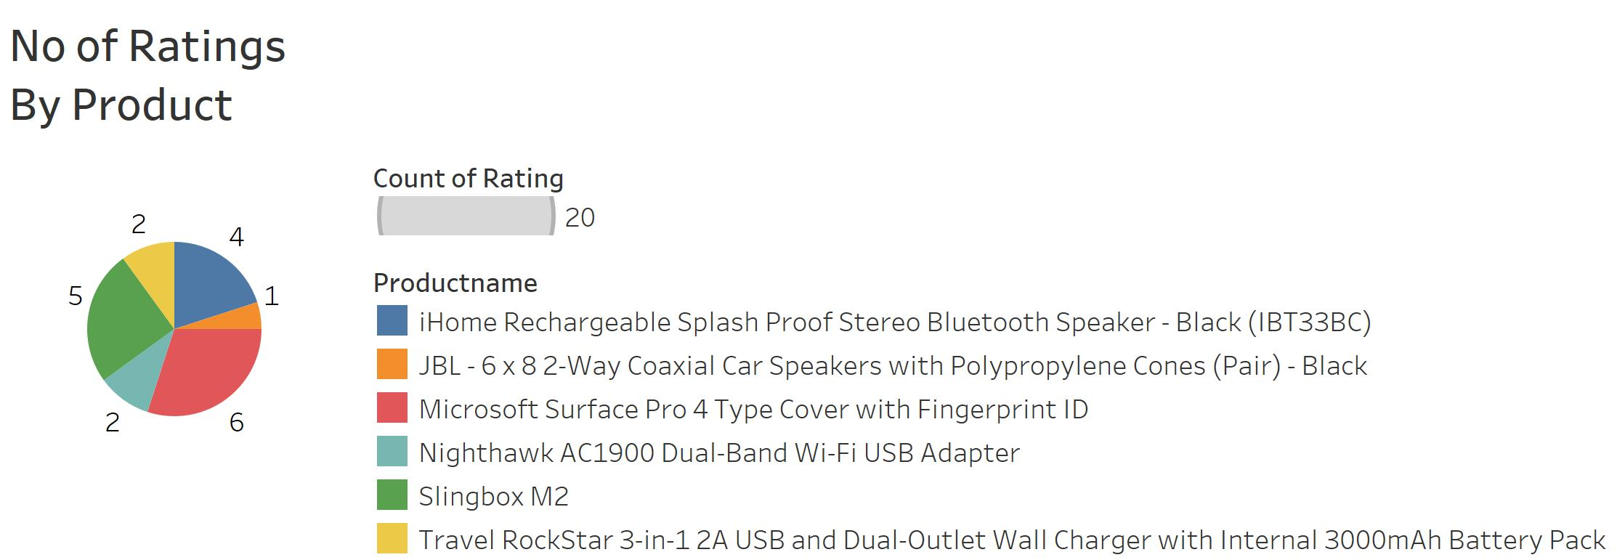
Ratings Per Product
This Pie-Chart tells number of ratings for each product, By this teams get an idea on the products to be excluded while taking average ratings into consideration.

Slide 20
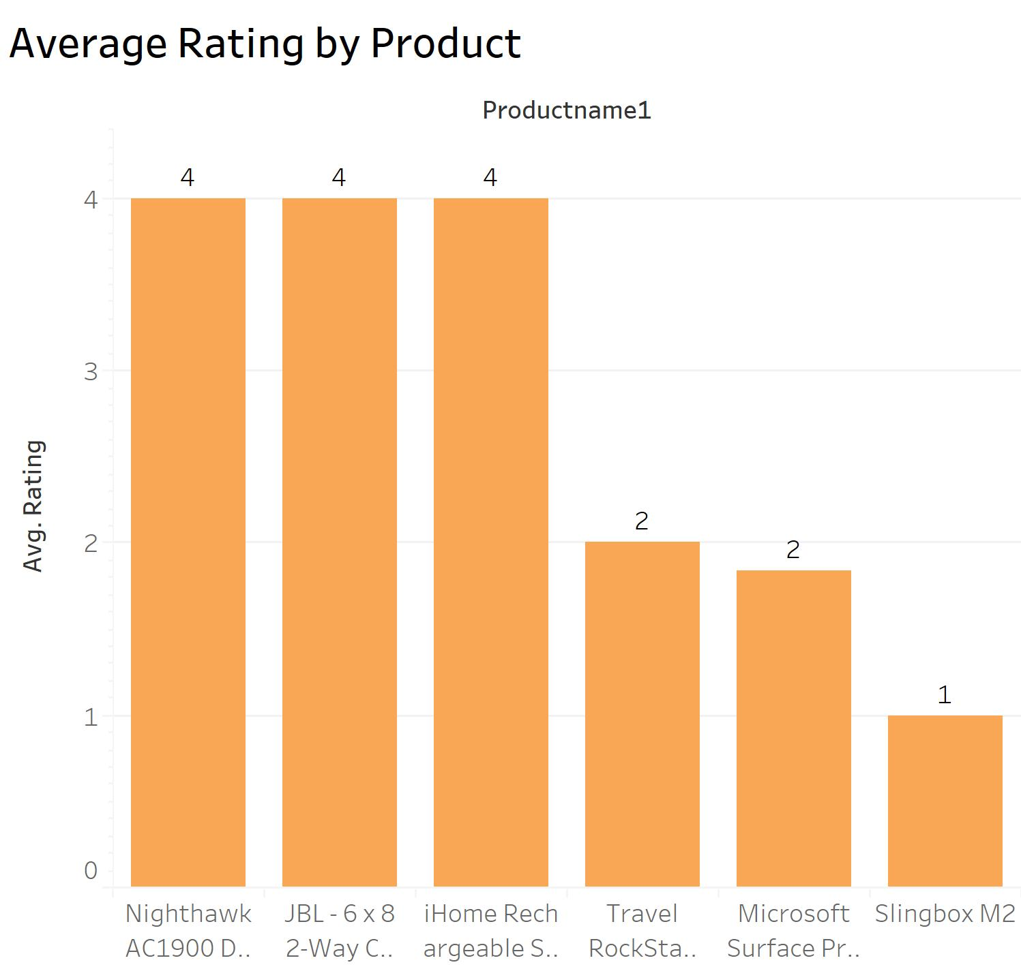
Average Rating
This chart gives a deeper – level view of the products that have less rating, Ops team can further deep-dive to specific products to know customer issues.

Slide 21
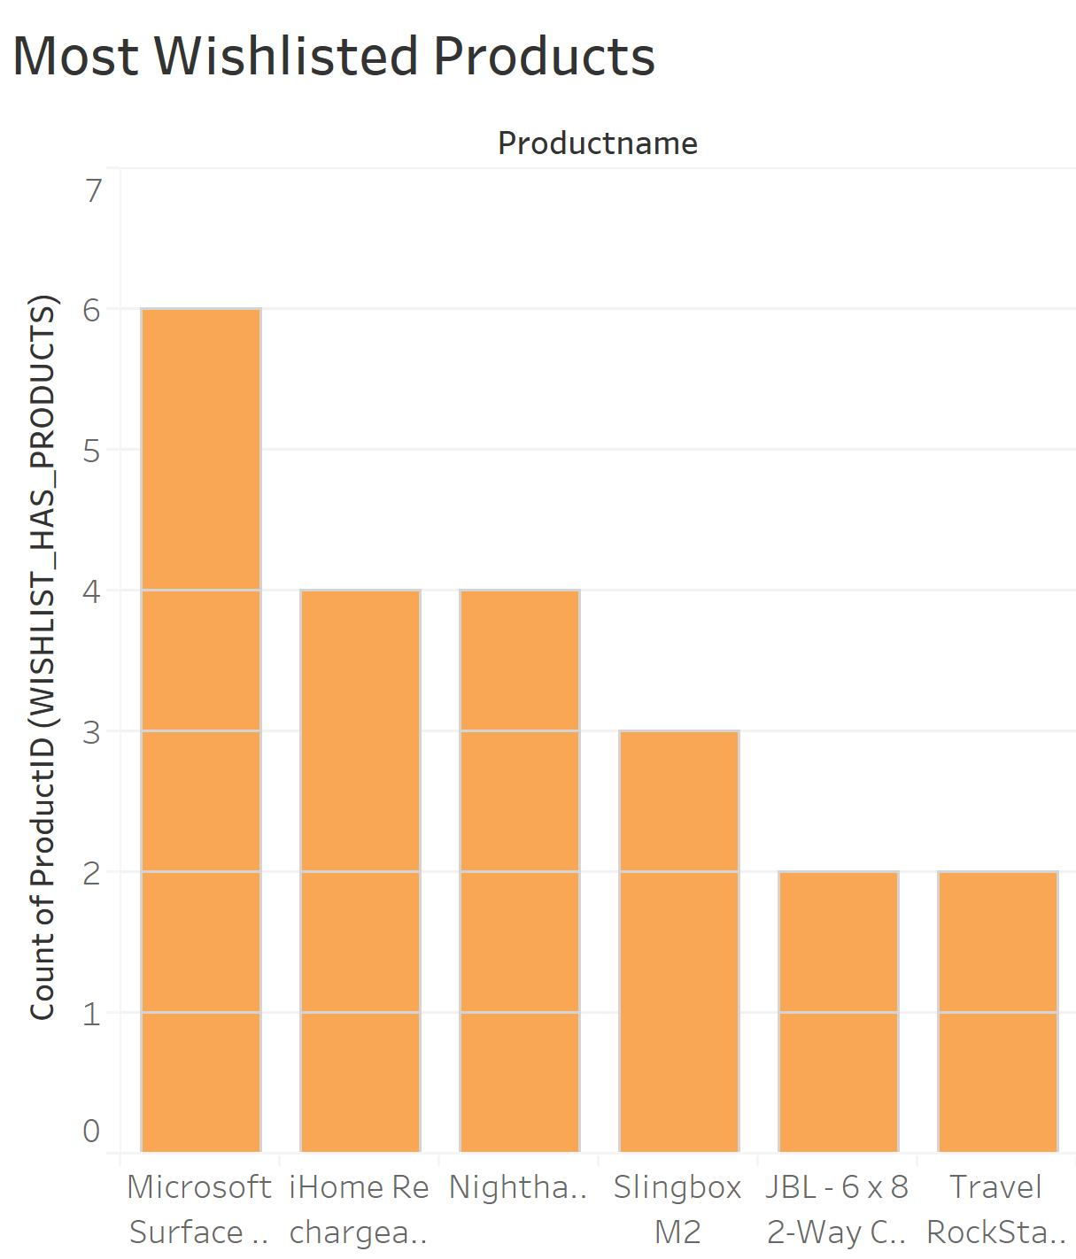
Wishlist-Product Demand
This Charts gives a complete view on customers wishlist products, By this operation teams can strategize their upcoming offers and maintain stock of the product by considering the demand of the product from wishlist entity.

Slide 22
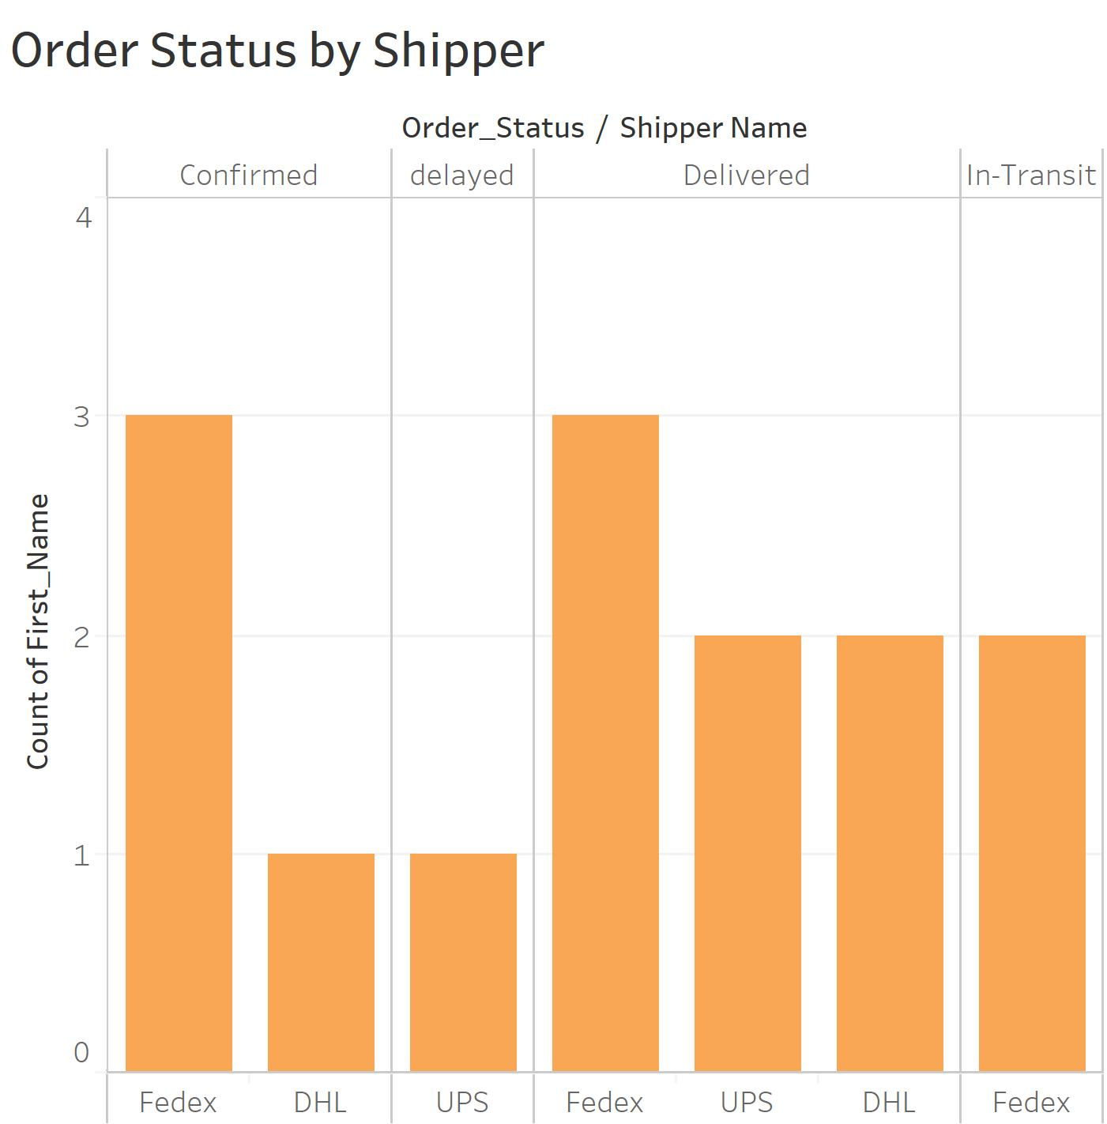
Order Status & Shipper
This chart helps the supply chain team to know the performance of orgs delivery model and also gets to know the shipment companies details that are leading to delay in delivery .

Slide 23
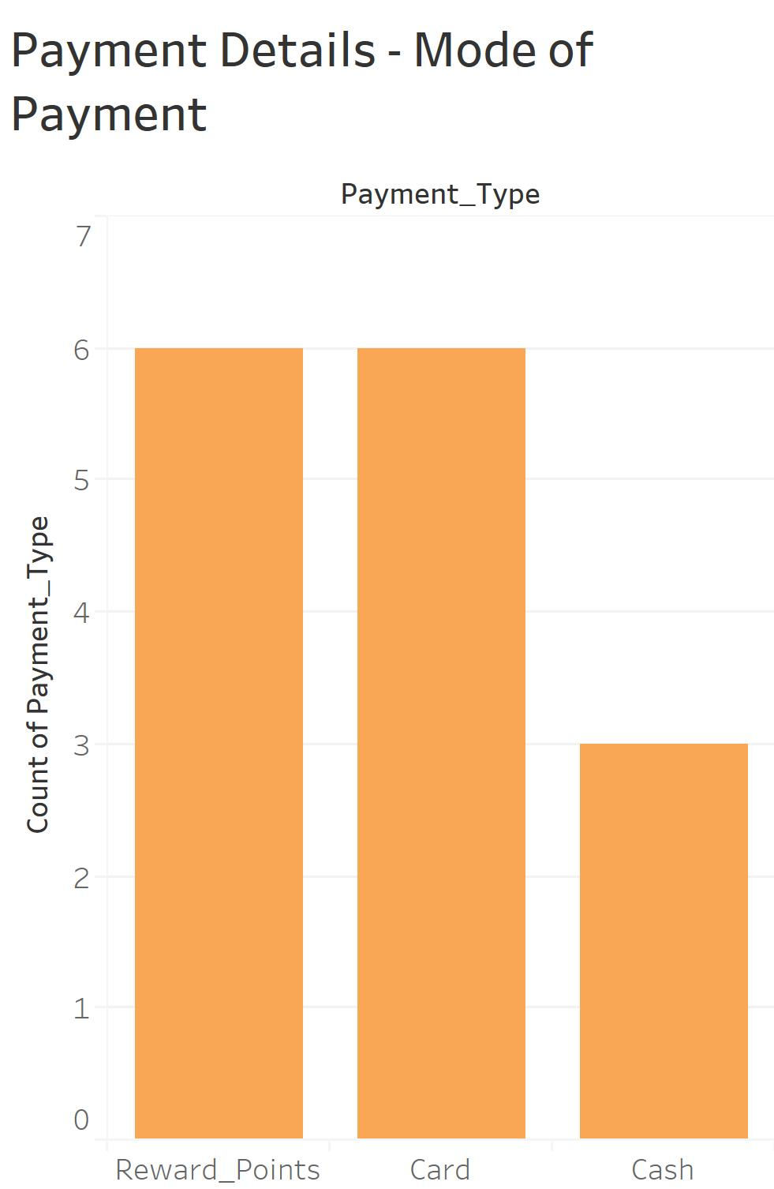
Mode of Payment -Breakdown
This chart helps to understand the payment method used by the customer. By this team can strategize the offers based on health reward points.

Slide 24

Team Contribution - Breakdown
1. Topic and Objectives
2. Database Design, Initial ERD
3. Final ERD
4. Database Implementation
-Stored Procedures
-Views
-Trigger
-Encryption
-Derived columns using functions
-Tableau Dashboard
5. Presentation Deck
All the 3 team members contributed equally in all the phases of the project.

Slide 25
Thank you!

